Slide 1
MIS 3301 Intro. to Business Programming Logic
Functions – PART 1
Functions, Top-down design, Void Functions, Local Variables, Passing Arguments
Mrs. Nancy G. Sánchez

Slide 2
Outline
Part 1
Functions
Top-down design
Void Functions
Local Variables
Passing Arguments
Positional Arguments vs Keyword Arguments
Passing Immutable Values

Slide 3
Functions

Slide 4
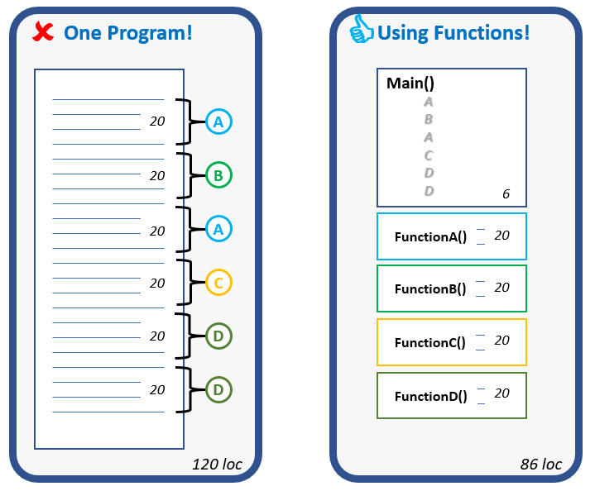

Why Write Functions?
Benefits of Functions
Reduction of complexity
Increase in code reusability
Speeds up development
Easier to test and maintain
Easier facilitation of teamwork
sortAsc()

Slide 5
What is a Function?
Function - a piece of prewritten code that performs an operation
While functions typically contain many lines of code, a well-written function should only one have one purpose.
We have been using the built-in functions that come with Python: print(), input(), int(), format(), etc. Now, we will learn to write our own functions.
There are 2 types of functions: void & value-returning.
Void
Functions
Value-Returning
Functions
Argument 0
Argument 0
Function
Function
…Argument n
…Argument n
Return
value
print('The name is:', name)
name = input('Enter name: ')

Slide 6
Functions: Naming Convention
Rules for naming Functions
Same as rules for variables!
must start with a letter or an underscore
after the 1st character, may contain letters, digits, or underscores
cannot contain spaces
cannot be a Python keyword
are case sensitive
+ Use descriptive VERB phrases
Issue? _______________
calc_value()
calc_age()
Issue? _______________
get_birthdate_and_calc_age()
get_birthdate()
calc_age()
Issue? _______________
read_data()
read_cust_file()

Slide 7
Top-down Design

Slide 8
Top-down Design
Top-down design is a technique to breakdown an algorithm into functions.
Hierarchy Charts show a list of functions and what each function calls.
It does not show the steps in each function; thus, still use flowcharts.
Project: Calc & display BMI
main()
get_height()
get_weight()
calc_BMI()
display_BMI_rpt()
Mainline
logic

Slide 9
Flowchart Examples
No Functions
One Function
Multiple Functions
Start
main()
get_height()
main()
Input height
get_height()
Input height in feet
get_height()
Input weight
Input weight
Input height in inches
get_weight()
Calc BMI
Calc BMI
Calc total height in inches
calc_BMI()
Display BMI rpt
Display BMI rpt
return
display_bmi_rpt
End
return
return
Which functions will be:
void functions? __
value_returning functions? __

Slide 10
Void Functions
A void function is a function that executes the statements that it contains and then simply terminates. It does not return a value to the calling program.
Void
Functions
Argument 0
Function
…Argument n

Slide 11
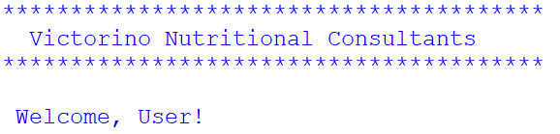
Example without Functions
#Display company header
print('*'*40)
print(' Victorino Nutritional Consultants')
print('*'*40)
#Display greeting
print('\n Welcome, User!')

Slide 12
Creating Functions
Let’s turn the company header code into a function …
def display_company_header():
print('*'*40)
print(' Victorino Nutritional Consultants')
print('*'*40)
Function header
Function
Definition
Block

Slide 13
Calling a Function – i.e. invoking
Functions do not execute unless they are “called” (i.e. “invoked”)
So, let’s now “call” the function ….
def display_company_header():
print('*'*40)
print(' Victorino Nutritional Consultants')
print('*'*40)
display_company_header()
Function call
“Calling/Invoking” a function
See next slide for a better approach – using main()

Slide 14
main() function
main()
display_company_header()
display_greeting()
We will include a main() function in our programs!
def main():
display_company_header()
display_greeting()
#continue with other code
def display_company_header():
print('*'*40)
print(' Victorino Nutritional Consultants')
print('*'*40)
def display_greeting():
print('\n Welcome, User!')
main()
Mainline logic
This executes 1st …but why?

Slide 15
Terminology: Calling vs Called Functions
This is the “Calling Function”
def main():
display_company_header()
display_greeting()
#continue with other code
def display_company_header():
print('*'*40)
print(' Victorino Nutritional Consultants')
print('*'*40)
def display_greeting():
print('\n Welcome, User!')
main()
Calling/Invoking a Function
This is the “Called Function”

Slide 16
Exercise 1 – Basic Functions
Copy the code below and save it as Ch5-Ex01-Basic-Function.py
Move the 2 parts of the code into separate functions. Name each function using an appropriate verb phrase such as:
display_title()
display_message()
Create a main() function to call both of the functions you created.
Test it.
#Ch5-Ex01-Basic-Function.py
#title
print()
print('*'*40)
print('Practicing Functions')
print('*'*40)
#message
print('\nWe have already learned to use functions such as:')
print(' - print(), input(), int(), float(), format(), etc')
print('\nNow, we are learning to write our own.\n')

Slide 17
Local Variables

Slide 18
Local Variables
A local variable is a variable defined within a function.
def main():
first_nm = input('Enter first name: ')
display_company_header()
display_greeting()
What is the Scope of a Local Variable? ____________

Slide 19
Local Variables cont.
def main():
first_nm = input('Enter first name: ')
display_company_header()
display_greeting()
def display_company_header():
print('*'*40)
print(' Victorino Nutritional Consultants')
print('*'*40)
def display_greeting():
print('\n Welcome,', first_nm)
main()
Debugging a Program with Functions
Enter first name: Bob
****************************************
Victorino Nutritional Consultants
****************************************
Traceback (most recent call last):
File "C:\...\example.py", line 14, in <module>
main()
File "C:\...\example.py", line 4, in main
display_greeting()
File "C:\...\example.py", line 12, in display_greeting
print('\n Welcome,', first_name)
NameError: name 'first_nm' is not defined
We can overcome this issue by passing arguments.

Slide 20
Passing Arguments

Slide 21
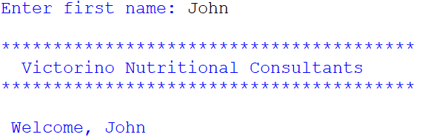
Passing Arguments
def main():
first_nm = input('Enter first name: ')
display_company_header()
display_greeting(first_nm)
def display_company_header():
print()
print('*'*40)
print(' Victorino Nutritional Consultants')
print('*'*40)
def display_greeting(first_name):
print('\n Welcome,', first_name)
main()
main()
Argument
(when calling a function)
display_company_header()
Parameter
(in the function header)
display_greeting()
first_name

Slide 22
Passing Arguments
def main():
sal = float(input('Enter salary: '))
increase_salary(sal)
def increase_salary(salary):
salary *= 1.1
print('New salary:', salary)
main()
argument
parameter

Slide 23
Exercise 2 – Passing Arguments
Copy the code below and save it as Ch5-Ex02-Passing-Arguments.py
Modify display_title()
Add a parameter called title_name & display that name instead of the hardcoded word ‘Functions’.
Run it. What happened? ________
Modify main():
Pass the hardcoded word ‘Functions’ as an argument in the display_title() function call.
Let’s make it more dynamic:
In main(), add a prompt at the beginning of main() asking the user to enter a topic – use the variable name topic.
Fix the call to the display_title() function so we pass it the user-inputted value.
#Ch5-Ex02-Passing-Arguments.py
def main():
display_title()
display_message()
def display_title():
print()
print('*'*40)
print('Practicing Functions')
print('*'*40)
def display_message():
print('\nWe have already learned to use functions such as:')
print(' - print(), input(), int(), float(), format(), etc')
print('\nNow, we are learning to write our own.\n')
main()

Slide 24
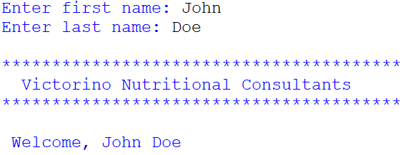
Passing Multiple Arguments
def main():
fn = input('Enter first name: ')
ln = input('Enter last name: ')
display_company_header()
display_greeting(fn, ln)
def display_company_header():
print()
print('*'*40)
print(' Victorino Nutritional Consultants')
print('*'*40)
def display_greeting(first_name, last_name):
print('\n Welcome,', first_name, last_name)
main()
2 Arguments
(when calling a function)
Parameters
(in the function header)

Slide 25
Positional Arguments vs Keyword Arguments
Positional Arguments
Keyword Arguments
def main():
fn = input('Enter first name: ')
ln = input('Enter last name: ')
display_greeting(fn, ln)
def display_greeting(first_name, last_name):
print('\n Welcome,', first_name, last_name)
main()
def main():
fn = input('Enter first name: ')
ln = input('Enter last name: ')
display_greeting(last_name=ln, first_name=fn)
def display_greeting(first_name, last_name):
print('\n Welcome,', first_name, last_name)
main()
Arguments must be in the same order as the parameters.
Allows you to place arguments in any order

Slide 26
Passing Immutable Objects
Recall that immutable types (e.g. strings, ints, floats, bools) cannot be updated.
When we pass an immutable object (e.g. strings, ints, floats, bools), the calling function (e.g. main) will NOT be aware when the called function (e.g. my_function) has changed the passed value because a new object is created.
Recall, the id() function returns the address of an object in memory.
def main():
a = 10
print('a:', a, 'at addr:', id(a))
my_function(a)
print('a:', a, 'at addr:', id(a))
def my_function(x):
print()
print('x:', x, 'at addr:', id(x))
x = 99
print('x:', x, 'at addr:', id(x))
print()
main()
def main():
a = 10
my_function(a)
print('a:', a)
def my_function(x):
x = 99
main()
a: 10 at addr: 1975202048592
a: 10 at addr: 1975202048592
Thus, main() - i.e. the calling function -
is not aware of the change
x: 10 at addr: 1975202048592
x: 99 at addr: 1975202239920
Notice that a new object is created because integers are immutable!
(this is true for strings, bools & floats too)
a: 10
Notice that the value of “a” in main
is NOT updated to 99.
But we can return the new value if we use a value-returning function – see next slides.

Slide 27

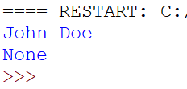
Keyword: None
Don’t make this mistake with void functions (i.e. function that do not have a return statement
def main():
ln = 'Doe'
fn = 'John'
generate_full_name(fn, ln)
def generate_full_name(first_name, last_name):
print(first_name + ' ' + last_name)
main()
def main():
ln = 'Doe'
fn = 'John'
print(generate_full_name(fn, ln))
def generate_full_name(first_name, last_name):
print(first_name + ' ' + last_name)
main()
None is an object of the class NoneType
It is basically like a null value/object
Void functions, return None

